Slide 1
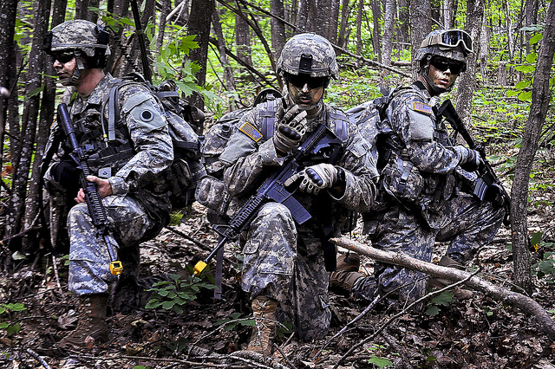
Incorporating Operational Adaptability into Training Exercises
Michael McCarthy
University of Central Florida
Notes:
Image size was reduced and brightness increased
Image source: https://www.flickr.com/photos/soldiersmediacenter/7486253346/in/photostream/

Slide 2
Table of contents
What is operational adaptability?
Why is it important in training?
Techniques for training exercises
The operational environment
The enemy
The civilians on the battlefield
Benefits for soldiers
Contact information

Slide 3
What is operational adaptability?
A mindset for soldiers
Tolerance for ambiguity
Collaborative planning
Flexibility of thought
Rapid adjustments to the situation
Actions shape the environment

Slide 4
Why is it important in training?
Capability for current and future leaders
Vast and complex threats
Regional instability
Extremist networks
Cyber warfare
Train as we fight

Slide 5
Techniques for training exercises
The operational environment
Terrain
Disposition of friendly forces
Logistics
Notes:
Afghanistan Air Drops
Image size was reduced, text box added via screen shot, cropped
Image source: http://cmsimg.airforcetimes.com/apps/pbcsi.dll/bilde?Site=M6&Date=20110528&Category=NEWS&ArtNo=105280309&Ref=AR

Slide 6
Techniques for training exercises
Replication of the enemy
Large scale armies
Non-state actors
Tactics, Techniques, and procedures (TTPs)
Weapons
Information Operations
Notes:
Chinese Army Soldiers
Image size was reduced, text box added via screen shot, cropped
Image source: http://www.wired.com/images_blogs/dangerroom/2013/05/pla-world-affairs-board.jpg
ISIS Fighters
Image size was reduced, brightness decreased, and text box added via screen shot
Image source: http://a.abcnews.com/images/International/AP_isis_kab_150211_1_16x9_992.jpg

Slide 7
Techniques for training exercises
The civilians on the battlefield
Displaced persons
Political structure
Support to government
Notes:
Mayor Meeting in Iraq
Image size was reduced, cropped, and text box added via screen shot
Image source: http://www.drum.army.mil/mountaineer/Lists/Articles/Attachments/2998/meeting.jpg
Jirga in Afghanistan
Image size was reduced, cropped, and text box added via screen shot
Image source: http://i1.tribune.com.pk/wp-content/uploads/2014/08/744293-jirga-1407212804.jpg

Slide 8
Benefits for soldiers
More realistic = better training
Refine TTPs at home station
Increase soldier confidence
Mission rehearsals
The more you sweat in peace
Notes:
The more you sweat in peace
Image size was reduced and brightness increased.
Image source: http://rlv.zcache.com/sweat_more_in_peace_bleed_less_in_war_posters-r512ed307b8a349baafff764e9ba2c6d7_zec_8byvr_512.jpg

Slide 9
Contact information
Contact Michael McCarthy for any questions on this presentation
Resources:
ADP 7-0, Training Units and Developing Leaders
US Army Combined Arms Center
US Army Training and Doctrine command
End Show

